Slide 1
Fast Track Istio
NDC Sydney 2020

Slide 2
Agenda
Microservices
Service Mesh
Kubernetes
Traffic
Management
Service
Discovery
Security
Istio Introduction
Pitstop
Pitstop
Observability
Pitstop
Gateway
Pitstop

Slide 3





Mentors
Rahul Rai
Engineering Manager at Zip Co
Over 12 years experience on web and cloud
Co-author Istio Succinctly
Tarun Pabbi
Lead Engineer at Nine Tech
Over 12 years experience on web and cloud
Co-author Istio Succinctly
https://bit.ly/istio-succinctly
thecloudblog.net
tarunpabbi.com
@rahulrai_in
@tarunpabbi7

Slide 4

Microservices
Independent development & deployment
Improved fault isolation
Independent technology stack
Better maintenance
Notes:
1m
Handles by small teams
Easy to maintain
Independent release cycle
Can be scaled indepednently
Error management at services level
Different technology stack

Slide 5

Microservices Deployment
Multiple service instances per host (Physical or VM)
Service instance per host (Physical or VM)
Service instance per container
Serverless deployment
Notes:
2m
https://dzone.com/articles/right-strategies-for-microservices-deployment
Challenges:
Varying frameworks and technologies
Independent resource requirements, scaling, and monitoring requirements
Deployment has to be quick, reliable, and cost-effective
1. Relatively efficient and fast resource usage
Little or complete lack of control on service instances unless each instance is a separate process
Lack of isolation
Higher risks of errors while deployment since the operations
2. allows you to run each instance separately on its host.
Under –utlization, costly, slow and time consuming
3. each service instance operates in its respective container,
Completely isolated, can manage resource allocation
Doesn't require physical separation,
Require better security management, may require more maintenance
4. managed service from cloud providers
Charged only per use
almost nil infra management requirerements
Canot be used for long running process,
Cannot be used for large resources consumption, input-output
Usually stateless

Slide 6


Kubernetes
Containers based deployment
Orchestration & cluster
Components
Control plane Node Pod CLI: kubectl
Notes:
2m
managing containerized workloads and services,
facilitates both declarative configuration and automation
Manages lifecycle, communication, security, monitoring of containers
Control plane - manages the state of objects in Kubernetes, handles all the k8s functions
Node – node may be a virtual or physical machine, actual workload VMs, runs services + control plane pod to communicate with Control plane
Pod --- Pods are the smallest deployable units of computing , may contain one or more containers, shared storage/network resources
Kubectl -- kubectl command line tool lets you control Kubernetes clusters

Slide 7


Kubernetes Objects
Deployment
Services
Cluster IP Nodeport Loadbalancer
Namespaces
Notes:
2m
Deployment - Deployment provides declarative updates for Pods ReplicaSets, describe a desired state in a Deployment, and the Deployment Controller changes the actual state to the desired state at a controlled rate
Services - expose an application running on a set of Pods as a network service
Namespaces - virtual clusters backed by the same physical cluster

Slide 8

Service Mesh
Manages service-to-service communication
Layer 5 through layer 1 of the OSI network stack
East-west networking
Notes:
1m
control how different parts of an application share data with one another
doesn’t introduce new functionality to an app’s runtime environment
Abstracts everything to a layer of infrastructure

Slide 9
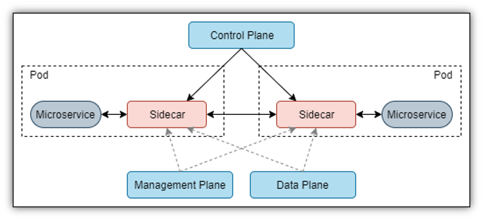

Service Mesh
Notes:
1m

Slide 10

Use cases
Improve observability of distributed services
Blue/Green deployments
Modernizing legacy applications
A/B Testing
Security
Much more..
Notes:
1m

Slide 11

Popular Services
Linkerd
Istio
Consul
Notes:
2m - T
When should I use Istio?
Use Istio when you:
Want fine-grained service to service authentication and authorization
Want complete control on traffic routing
Want a rich metric collection
Want multi-cloud extensibility
Used to the Kubernetes way of configuring resources
Linkerd is a Cloud Native Computing Foundation (CNCF) project. CNCF is the same organization which once incubated the Kubernetes project.
Linkerd aims to be a transparent service mesh. It gives you a bunch of benefits of using a service mesh (like authentication, encryption, etc.) out of the box.
You lose out on a lot of configurability which you had with Istio
When should I use linkerd?
Use Linkerd when you:
Want to get started with a service mesh in no time and don’t really care about it’s working
Are working on a single tenant Kubernetes cluster
Don’t need complex routing rules
Want a service mesh which doesn’t scare away your team
Consul Connect is a DIY kind of a service mesh. It’s a part of the popular Hashicorp suite of tools.
An important distinction from Linkerd and Istio is that Consul is first a service discovery and configuration tool.
When should I use Consul?
Use Consul Connect when you:
Already have a Nomad / Consul cluster running
Cannot use Kubernetes due to any reason
Want multi-cloud extensibility
Love controlling how things work
Want to learn how service meshed work under the hood

Slide 12

Istio
Created by Google, IBM, and Lyft
Perfect companion to K8s
Decoupled from workload
Manages security, policy and observability
Notes:
1m - R

Slide 13

Traffic Management
Managed service discovery
Direct traffic via Envoy proxies
Enforce traffic policies
Notes:
1m

Slide 14

Observability
Detailed telemetry of events within the mesh
Metrics based on latency, traffic, errors and saturation
Distributed traces across services within the mesh
Logs for each request and response within the mesh
Notes:
2m

Slide 15

Security
Traffic encryption
Mutual TLS and fine-grained access policies
Audit
Notes:
1m
To defend against man-in-the-middle attacks, they need traffic encryption.
To provide flexible service access control, they need mutual TLS and fine-grained access policies.
To determine who did what at what time, they need auditing tools.

Slide 16
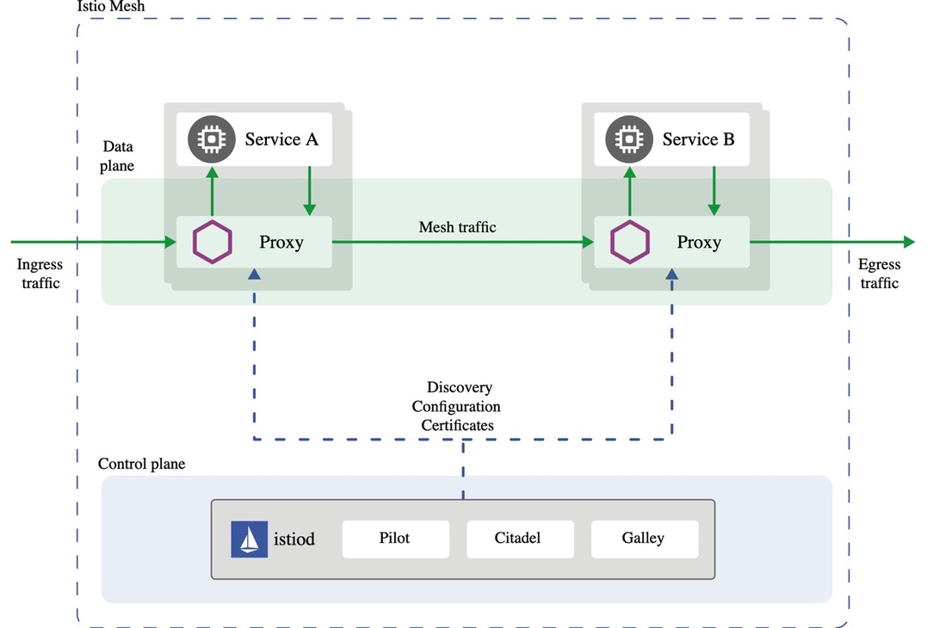
Architecture
source: istio.io
Notes:
2m
Data Plane
Envoy
High performance proxy (C++)
Acts as a gateway to pod container(Inbound/Outbound)
L7 proxy
Support Http(s), Http2, gRPC, TCP
Standard metrics
Deployed as sidecars
Control Plane
Istiod – Pilot
Service discovery for envoy
Traffic management
A/B testing
Failover
Circuit breaker
Canary rollout
Retries
Timeouts
Control Plane
Istiod – Citadel
Authorization and Authentication
Identity & Credential management
Supports mTLS in permissive and strict mode
Control Plane
Istiod – Galley
Handle Configuration management
Ingest, Process, Distribute, Validate

Slide 17

Installation
istioctl
Standalone operator
Custom Helm charts
Notes:
1m
Tip : Use same istioctl version as istio
Istioctl
Istio command line client
User input validation
Helper commands like verify-install, version, proxy-status etc.

Slide 18
Exercise 1
Installation – 10 mins
Notes:
T- end – 9:35 end

Slide 19
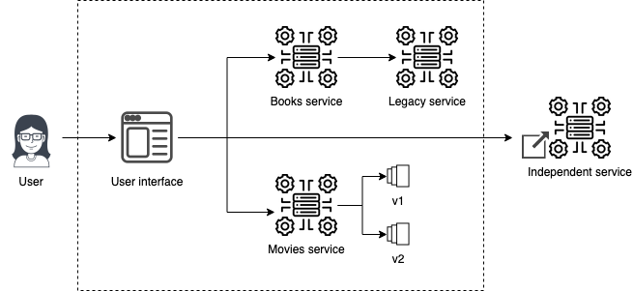
Book Club
Notes:
10m

Slide 20

Sidecar Deployment
Namespace injection
Manual injection using istioctl
Notes:
1m

Slide 21
Exercise 2
Deploying Applications – 10 mins
Notes:
9:45end

Slide 22
Cleanup – Local
Delete the folder my-workshop from your working directory
Execute the command: kubectl delete namespace fast-track-istio
Notes:
9:45end

Slide 23

Ingress Gateway
Expose services outside the cluster
Manages inbound traffic
Layer 4-6 load balancing
Notes:
2m
Gateway describes a load balancer operating at the edge of the mesh
Handles TLS termination/Passthrough
Handles host-based routing

Slide 24
Exercise 3
Ingress Gateway – 10 mins
Notes:
Checkpoint – 10:00– break – R end

Slide 25
Cleanup – Local
Delete the folder my-workshop from your working directory
Execute the command: kubectl delete namespace fast-track-istio
Notes:
9:45end

Slide 26
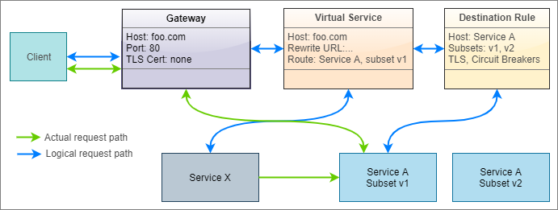
Traffic Management
Notes:
Let’s briefly discuss how the various APIs work together to logically drive a request to its target. Assume that a client wants to access version 1 of service A by sending a request to hostname foo.com. The following diagram presents the logical path that the request takes to reach the destination service both from outside the cluster and inside the cluster.
The requests originating outside the cluster first meet the ingress gateway, which is configured to only accept HTTP requests to hostname foo.com on port 80. A virtual service is bound to the gateway so that it receives any request received by the gateway. For services that communicate within the mesh, the gateway component is absent, and therefore, the request is received directly by the virtual service, which then rewrites the input URL of the service to the URL of service A within the cluster (for example, foo.com to serviceA.svc.default.cluster.local). A destination rule defines the subsets of service A, (for example, version 1 and version 2), and the virtual service directs the requests to one of the subsets based on match conditions that you can specify on layer 7 request attributes.
Remember that the gateway, virtual service, and destination rule are just programming constructs that execute within the Envoy proxy, and therefore, physically, the request only travels from the ingress gateway Envoy instance to the destination service Envoy instance, from where it reaches the destination service.

Slide 27

Virtual Service
Rules to route traffic to destination
Each routing rule defines criteria for traffic redirection
Rules are evaluated in sequence (Or’ed)
Declaration is optional
Notes:
1m
Virtual Service
Route based on user identity
Route to % of users
Fault Injection
Retries
Timeouts
Modify request/response headers
***Without Virtual service, K8s default round robin load balancing is used.
****Each VS gets a version by default if we don’t define
Istio populates its only service registry
Istio sidecars are deployed on all pods

Slide 28
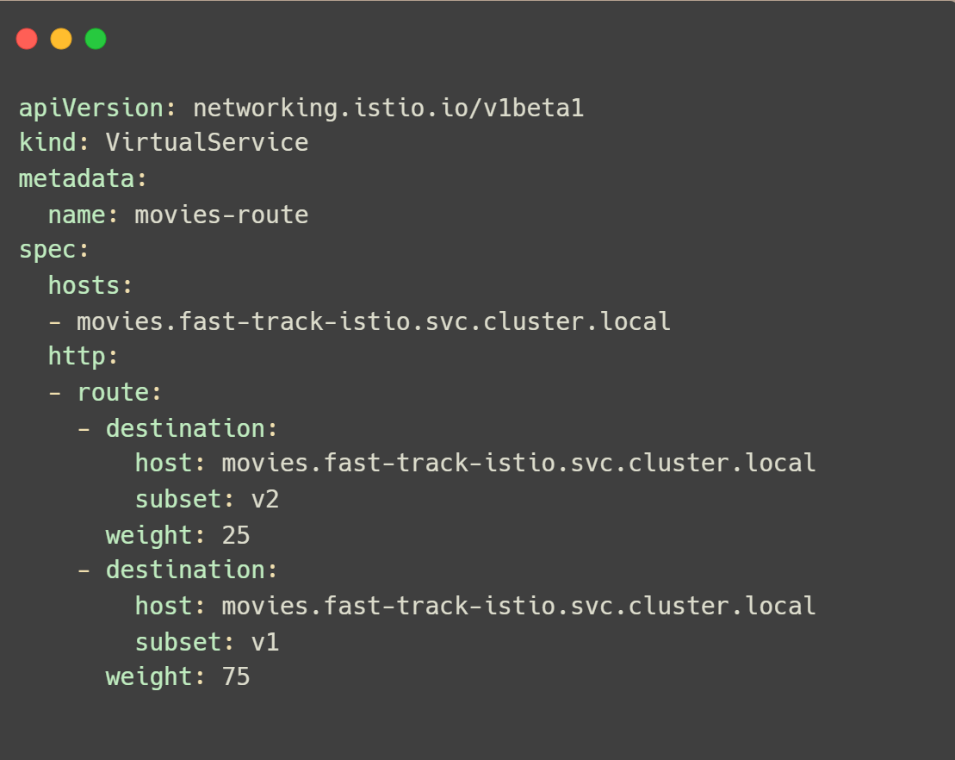
Virtual Service
Notes:
1m

Slide 29

Destination Rule
Determines how the destination services are invoked
Applied to the connection after the route of the request has been determined by the proxy
Allow operators to configure features such as load balancing, TLS etc.
Notes:
2m
Traffic policy can be defined at service level or subset level
Destination Rule
Load Balancing
Connection pool size
Detect and evict unhealthy hosts
Authentication
Circuit breaking
Rate limiting
Load balancing
K8s load balancing -> round robin
With Istio
Least Conn
Random only
Destination rule – Rate limiting
Maximum connection & timeouts at service level
Applied at TCP and/or Http level

Slide 30
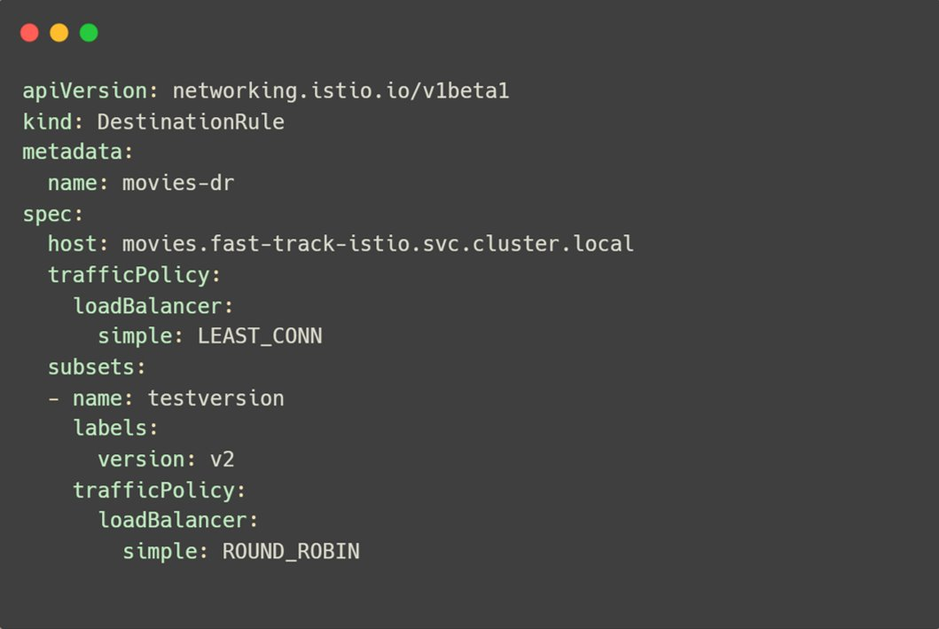
Destination Rule
Notes:
30s

Slide 31

Traffic Management Patterns
Canary
Routing a portion of the application traffic to a new workload
Routing of traffic by percentage or request attributes
Configured with Virtual Service destination attribute
Notes:
1m

Slide 32

Traffic Management Patterns
Fault Injection
Configure faults for a percentage of HTTP traffic
Check impact of failure of dependent services
Configured with Virtual Service fault attribute
Notes:
1m

Slide 33

Traffic Management Patterns
Versioning
Rollout traffic to the latest version of an application
Rules based on OSI layer 4-7 request attributes
Configured with Virtual Service subset attribute
Notes:
1m

Slide 34
Exercise 4
Traffic Management 1 – 15 mins
Notes:
T - end

Slide 35
Cleanup – Local
Delete the folder my-workshop from your working directory
Execute the command: kubectl delete namespace fast-track-istio
Notes:
9:45end

Slide 36

Traffic Management Patterns
Resilience
Degrade gracefully on failure
Inbuilt features such as outlier detection, timeouts, retries
Configured with Virtual Service attributes: retries, timeouts etc.
Notes:
1m

Slide 37

Traffic Management Patterns
Mirroring
Duplicate requests to two versions of a service
Does not affect performance of the current service
Configured with Virtual Service mirror attribute
Notes:
1m

Slide 38
Exercise 5
Traffic Management 2 – 10 mins

Slide 39
Cleanup – Local
Delete the folder my-workshop from your working directory
Execute the command: kubectl delete namespace fast-track-istio
Notes:
9:45end

Slide 40

Service Entry
Adds a new entry in Istio service registry
Enables adding workloads outside the cluster to the mesh
Enables applying traffic management policies such as retries, timeouts, circuit breaking to external services
Notes:
1m
Redirect and forward traffic for external destinations, such as APIs consumed from the web, or traffic to services in legacy infrastructure.
Define retry, timeout, and fault injection policies for external destinations.
Run a mesh service in a Virtual Machine (VM) by adding VMs to your mesh.
Logically add services from a different cluster to the mesh to configure a multicluster Istio mesh on Kubernetes.

Slide 41
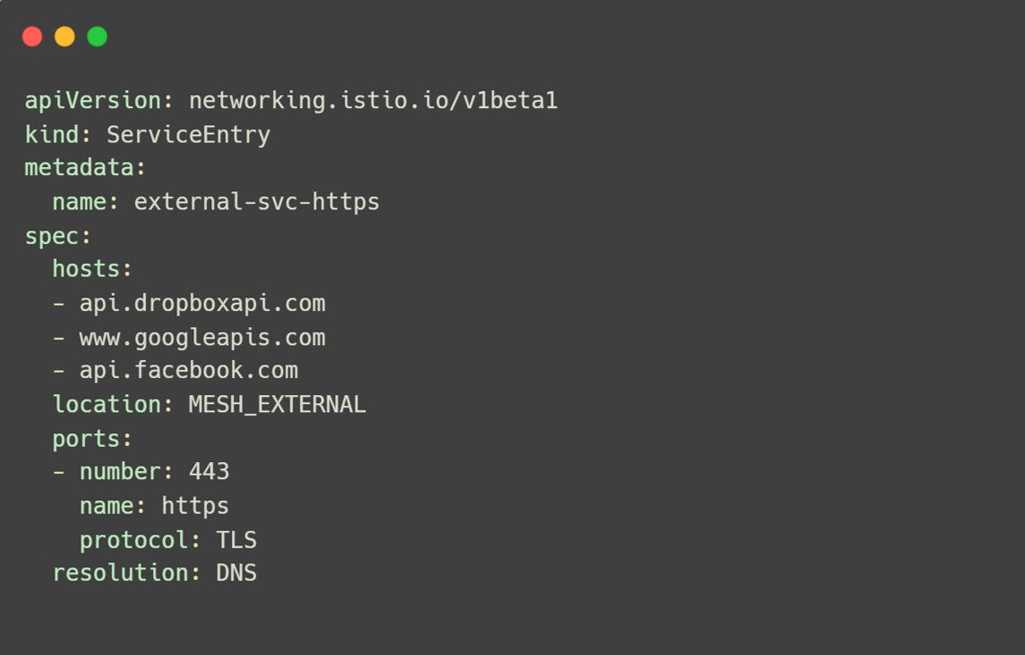
Service Entry
Notes:
1m
You don’t need to add a service entry for every external service that you want your mesh services to use. By default, Istio configures the Envoy proxies to passthrough requests to unknown services. However, you can’t use Istio features to control the traffic to destinations that aren’t registered in the mesh.

Slide 42
Exercise 6
Service Discovery – 10 mins
Notes:
Checkpoint 2 – 11:00 – break – R end

Slide 43
Cleanup – Local
Delete the folder my-workshop from your working directory
Execute the command: kubectl delete namespace fast-track-istio
Notes:
9:45end

Slide 44
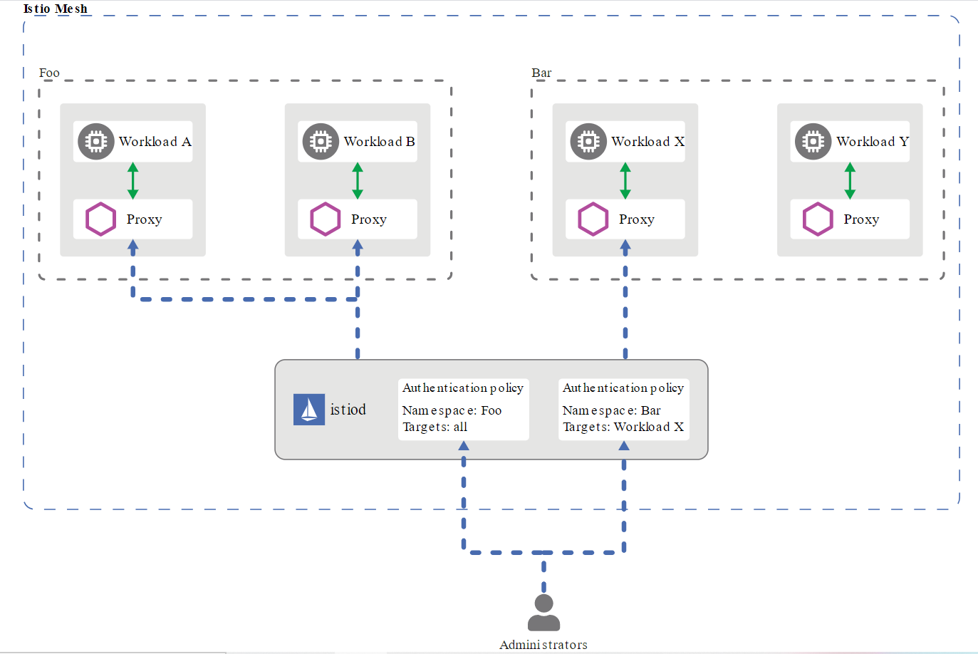
Security – Authentication
source: istio.io
Notes:
1m

Slide 45

Security - Authentication
Peer Authentication
Credentials of the service sending the request
mTLS Configured at global, service or namespace level
Request Authentication
Credentials of the user/service account/device making the request
Supports JWT
Notes:
2m
Peer authentication: used for service-to-service authentication to verify the client making the connection. Istio offers mutual TLS as a full stack solution for transport authentication, which can be enabled without requiring service code changes. This solution:
Provides each service with a strong identity representing its role to enable interoperability across clusters and clouds.
Secures service-to-service communication.
Provides a key management system to automate key and certificate generation, distribution, and rotation.
Request authentication: Used for end-user authentication to verify the credential attached to the request. Istio enables request-level authentication with JSON Web Token (JWT) validation and a streamlined developer experience using a custom authentication provider or any OpenID Connect providers, for example:
ORY Hydra
Keycloak
Auth0
Firebase Auth
Google Auth
In all cases, Istio stores the authentication policies in the Istio config store via a custom Kubernetes API. Istiod keeps them up-to-date for each proxy, along with the keys where appropriate. Additionally, Istio supports authentication in permissive mode to help you understand how a policy change can affect your security posture before it is enforced.

Slide 46
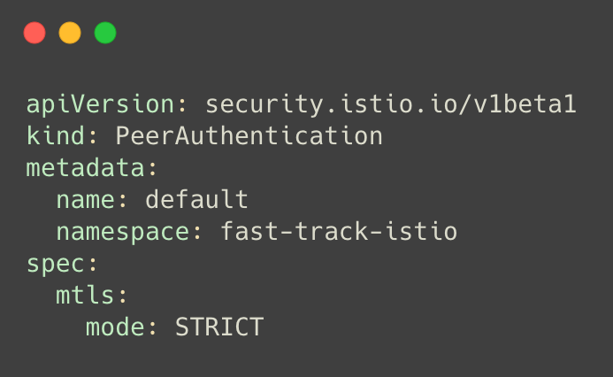
Authentication
Notes:
30s
PERMISSIVE: Workloads accept both mutual TLS and plain text traffic. This mode is most useful during migrations when workloads without sidecar cannot use mutual TLS. Once workloads are migrated with sidecar injection, you should switch the mode to STRICT.
STRICT: Workloads only accept mutual TLS traffic.
DISABLE: Mutual TLS is disabled. From a security perspective, you shouldn’t use this mode unless you provide your own security solution.
Istio re-routes the outbound traffic from a client to the client’s local sidecar Envoy.
The client side Envoy starts a mutual TLS handshake with the server side Envoy. During the handshake, the client side Envoy also does a secure naming check to verify that the service account presented in the server certificate is authorized to run the target service.
The client side Envoy and the server side Envoy establish a mutual TLS connection, and Istio forwards the traffic from the client side Envoy to the server side Envoy.
After authorization, the server side Envoy forwards the traffic to the server service through local TCP connections.

Slide 47
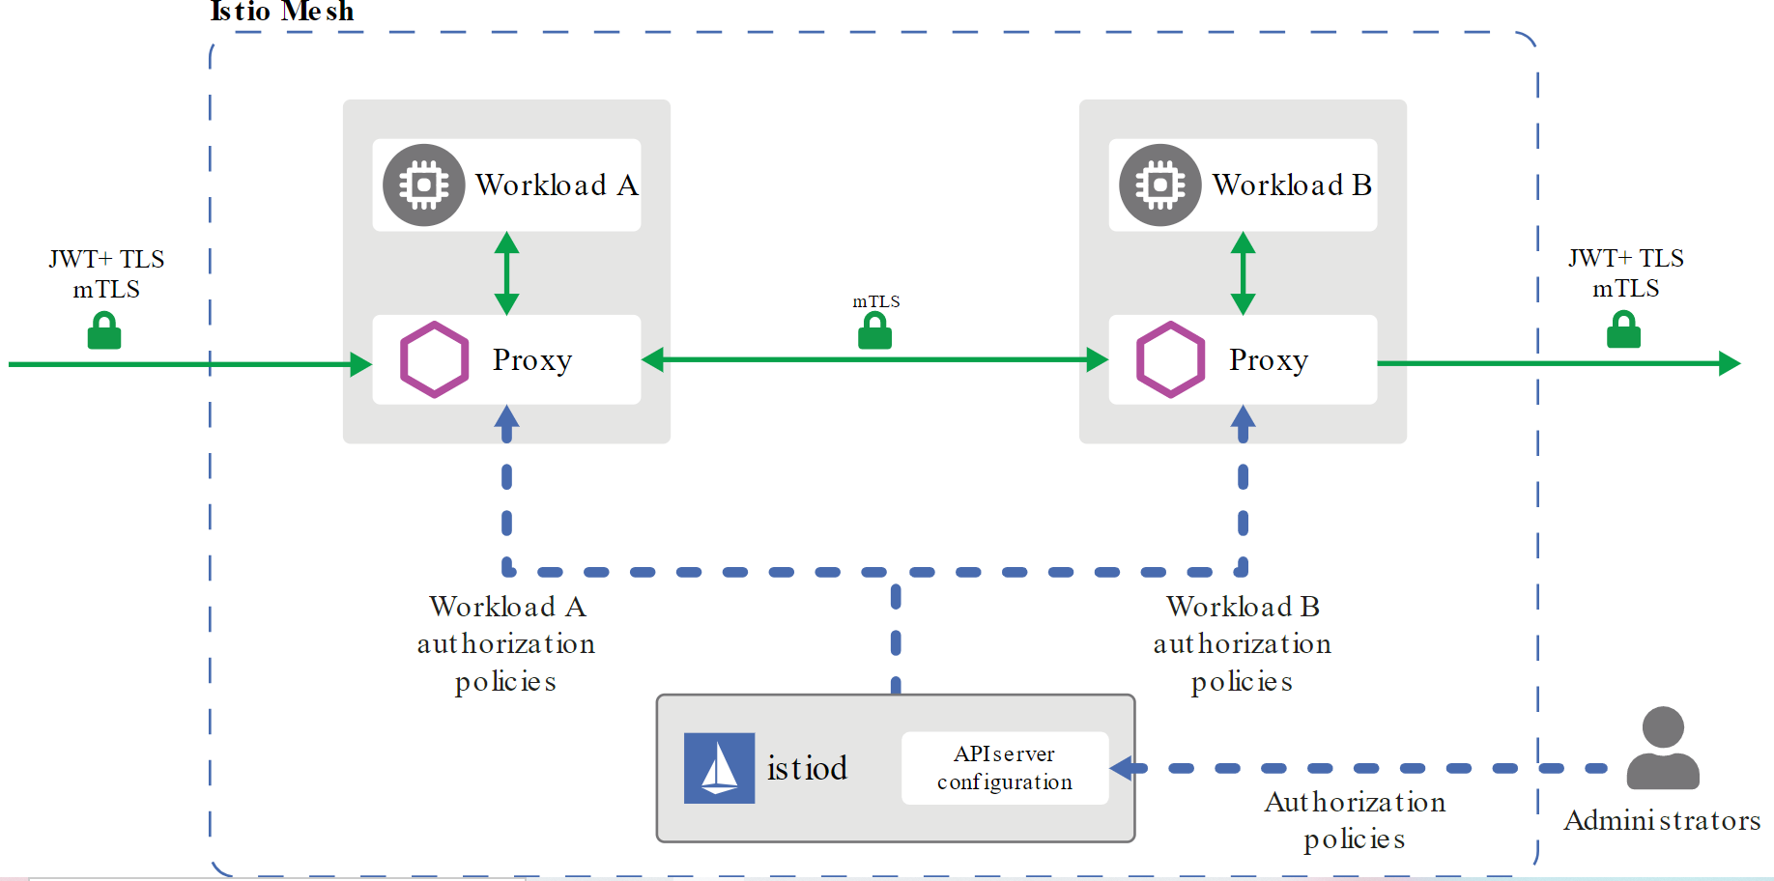
Security - Authorization
source: istio.io
Notes:
1m

Slide 48

Security - Authorization
Authorization Policy
Enforce access control on service-to-service communication channels
Allows both DENY and ALLOW policies for easier onboarding
Can be scoped to a gateway up to an endpoint of a service
Notes:
2m
The deny policies take precedence over allow policies. If any allow policies are applied to a workload, access to that workload is denied by default, unless explicitly allowed by the rule in the policy. When you apply multiple authorization policies to the same workload, Istio applies them additively.

Slide 49
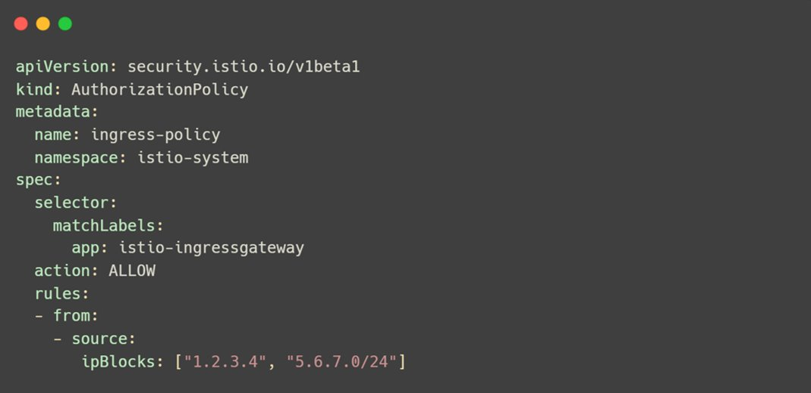
Authorization Policy
Notes:
1m

Slide 50
Exercise 7
Security – 15 mins
Notes:
T- end

Slide 51
Cleanup – Local
Delete the folder my-workshop from your working directory
Execute the command: kubectl delete namespace fast-track-istio
Notes:
9:45end

Slide 52

Observability
Metrics e.g. error rate, total request count, and response size
Traces with Jaeger, Zipkin, etc. that follow OpenTracing standards
Logs from Envoy
Notes:
1m

Slide 53

Prometheus
Service level metrics
Latency Errors Traffic Saturation
Proxy level metrics
Control level metrics
Notes:
2m
Istio generates metrics of all service in mesh and send them to Prometheus by default
Istio adds default metrics by you can add/remove metrics via Envoy filters
utilization is the percentage of time that the resource is busy, or the percentage of the resource’s capacity that is in use.
saturation is a measure of the amount of requested work that the resource cannot yet service, often queued.
errors represent internal errors that may not be observable in the work the resource produces.
availability represents the percentage of time that the resource responded to requests. This metric is only well-defined for resources that can be actively and regularly checked for availability.

Slide 54

Prometheus – HTTP Metrics
istio_requests_total
Count every request handled by envoy proxy
istio_requests_duration_seconds
Duration of requests
istio_requests_bytes
Http request body sizes
istio_response_bytes
Http response body sizes

Slide 55

Jaeger
Distributed tracing system by Uber
Configure tracing without application code change
Managed with Envoy proxy
Notes:
1m

Slide 56

Grafana
Open source visualization tool for monitoring
Create custom or use built in dashboards
Integrates with Prometheus
Notes:
1m

Slide 57

Kiali
Integrates with Prometheus to display service-service interactions
Check health of services
Better metrics than Grafana as it includes the whole communication stack
Configuration error detection and remediation
Notes:
1m

Slide 58
Exercise 8
Observability – 20 mins

Slide 59
Cleanup – Local
Delete the folder my-workshop from your working directory
Execute the command: kubectl delete namespace fast-track-istio
Notes:
9:45end

Slide 60
Debugging tips
$ istioctl version --remote=false
$ istioctl verify-install
$ istioctl authn tls-check <podname>
$ istioctl proxy-status
Notes:
1m
istioctl version --remote=false without remote – it will display all components versions
istioctl verify-install Verify all components

Slide 61
Fast Track Istio
NDC Melbourne 2020
thecloudblog.net
tarunpabbi.com
@rahulrai_in
@tarunpabbi7

